Slide 1
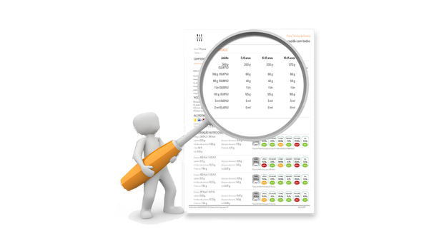
OBJETIVOS
ELABORAÇÃO DE OBJETIVOS
DESCRIÇÃO DA AÇÃO
CONDIÇÕES DE REALIZAÇÃO
CRITÉRIOS DE ÊXITO
Organização e descrição do que se pretende.
Onde, quando e quem.
Objetivos - Comportamentos desejados
Funções
Regras
Espaço
Tempo
Número
Táticos, técnicos, físico e psicológicos
Cognitivos
Formativos

Slide 2
EXERCÍCIO DE TREINO
especificidades
Nível de desempenho
TEMPO
OBJETIVOS
ORGANIZAÇÃO

Slide 3
EXERCÍCIO DE TREINO
ORGANIZAÇÃO TIPO
INTRODUTÓRIA
ADAPTAÇÃO ORGANIZAÇÃO
QUALIDADE
CONSOLIDAÇÃO
FUNDAMENTAL

Slide 4
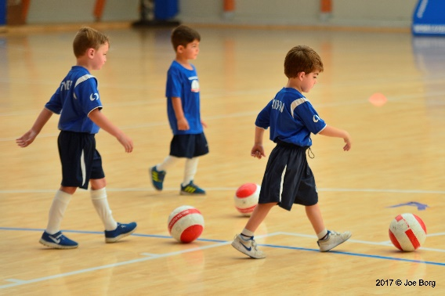
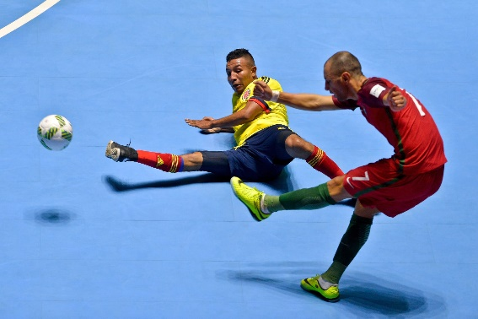
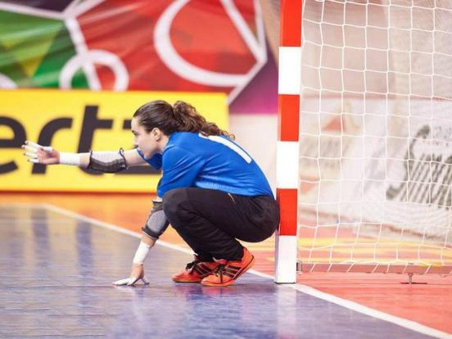
EXERCÍCIO DE TREINO
ALGUMAS PARTICULARIDADES
BOLA
ALVO / BALIZAS
OPOSIÇÃO
ESPAÇO/REFERÊNCIAS = COMPETIÇÃO
REGRAS = COMPETIÇÃO
CONDICIONANTES orientadas para objetivos

Slide 5
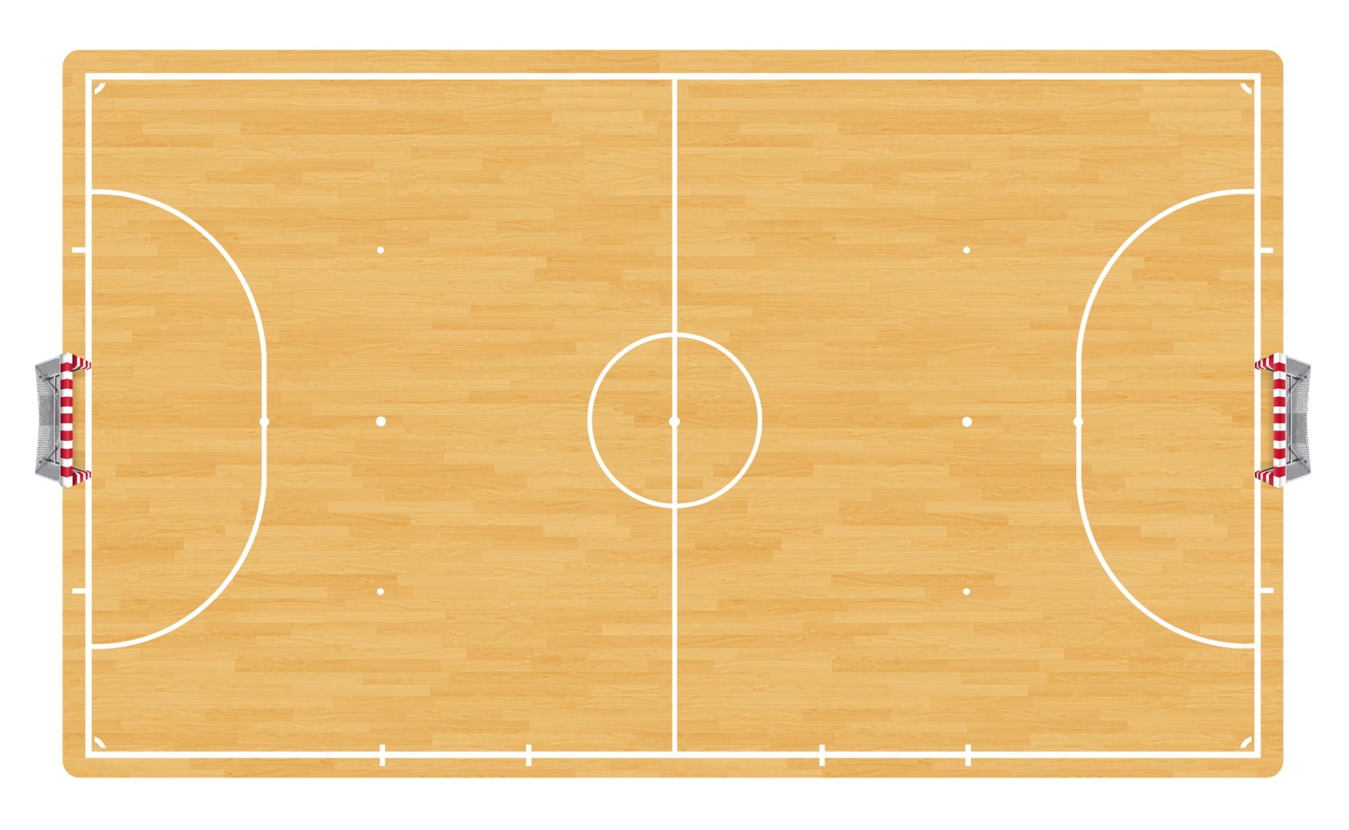
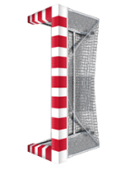
SESSION …
REDUCED FIELD GAME
MATCH ORGANIZATON
MATERIAL
1 Ball
2x6 Bibs
2 Goals
TIME SPACE NUMBER
1x15 min
28x20
GK+4+2v2+4+GK
2 teams - Red team v White team.
GLOBAL OBJECTIVES
Offensive organization against low block defense
1st line jumping
2^{nd line} changing
Defensive and offensive adaptations
ORGANIZATION & RULES
Normal play, only restart after scoring or ball goes out.
Playing with 2 side and 2 deep supports.
Rules:
Attaking ½ pitch supports can only pass and must stay playing outside.
Defending ½ pitch must enter playing after ball control and player that pass the ball change to support position.
White team: if support player pass directly to pivot he stays as a support and the player inside stays attacking.
Upgrade:
After defending ½ pitch player enter, attacker stay and the opposite side defender support must enter.
After playing GK+4v4+GK the exercise restarts.
ATTACK
DEFENSE
COGNITIVE
4:0 movements
20-40 situation
One-two move
Shooting by 2nd
3:1 movements
20-40 situation
Direct combination
Indirect combination
One-two move
Shooting by 2nd
0-20 defense
Jumping when high pressing
1st and 2nd line changing
Defensive adaptations
Cut between line pass to pivot
Communication
Perception
Adaptation
Decision making

